Slide 1

Decision Trees
Pemba Sherpa, Ben Grudt, Colin Beveridge, Amy Yucus

Slide 2

“We are the data professionals. We speak for the decision trees.”
- Us probably

Slide 3
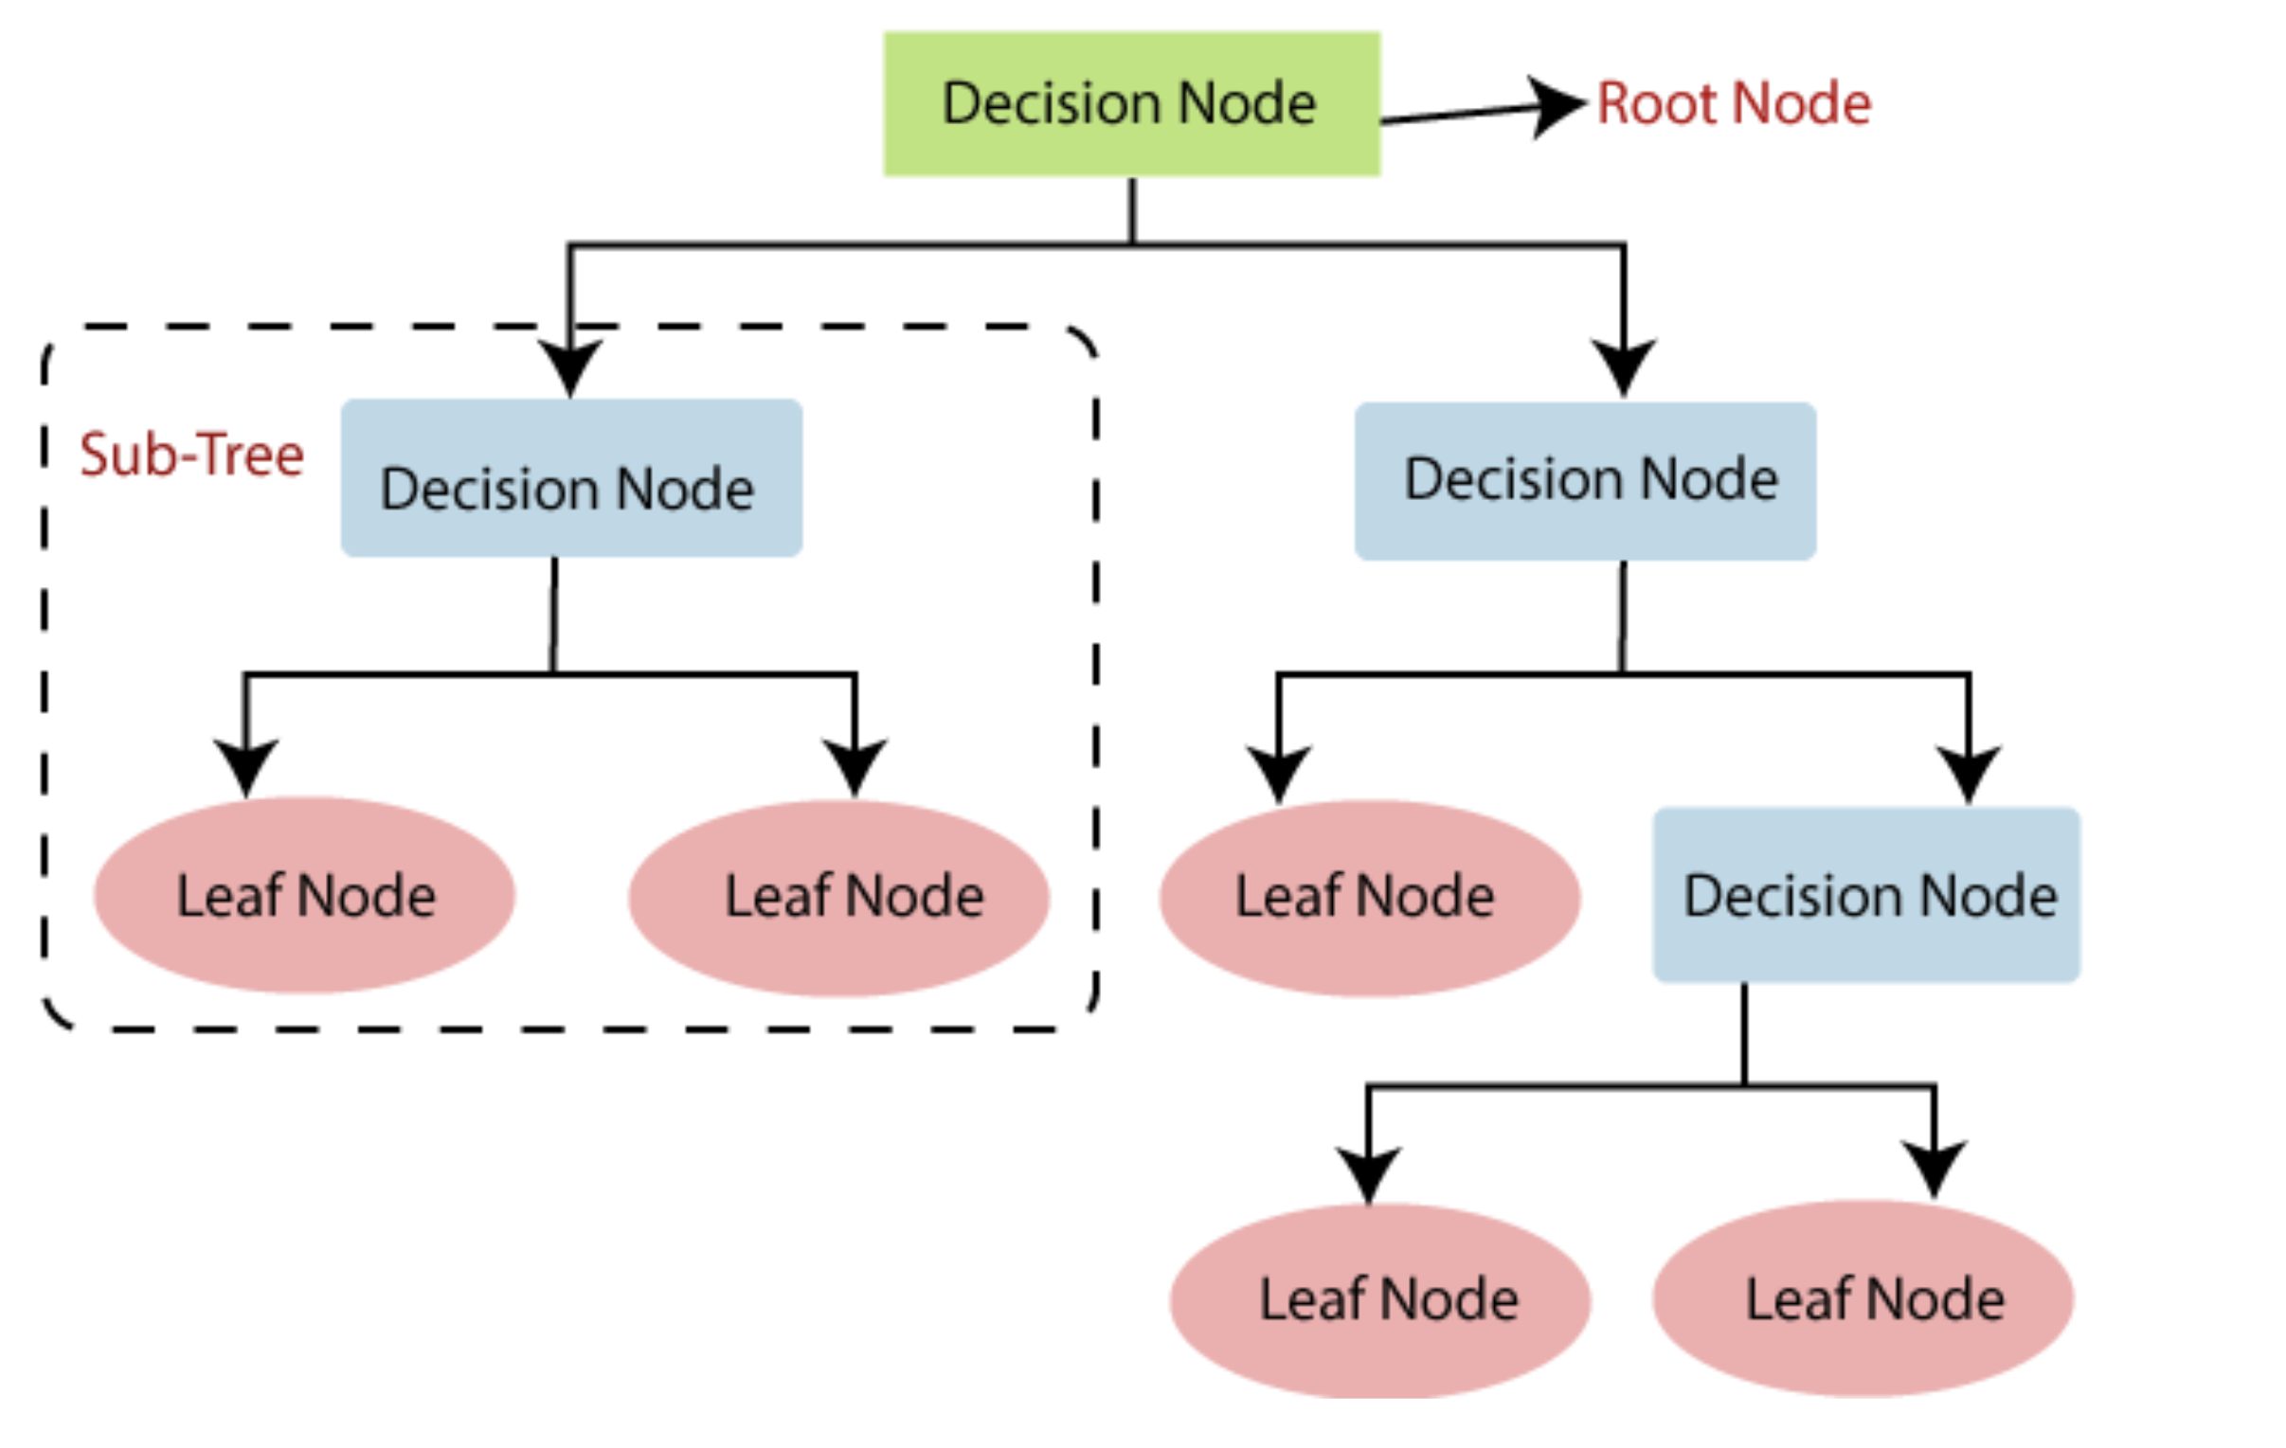
Decision Tree Basics
Goal: Find the most predictive possible combination of features and thresholds to classify final state.
Method: Minimize entropy, maximize information gain at each branch.
Supervised learning classification algorithm.
https://www.javatpoint.com/machine-learning-decision-tree-classification-algorithm

Slide 4
Vocabulary
Root Node – First node of the tree. Dataset begins dividing from this node. Synonymous with the entire dataset.
Branch – One possible class of a node. Branches can have their own subtrees, or end in a leaf node.
Sub Tree – A decision tree for which the parent node is not the entire dataset.
Decision Node – Nodes that arise after the root node that have at least two branches.
Leaf Node – A node with no branches arising from it. In some cases, it is a completely pure node, and in others it is very close to completely pure.

Slide 5
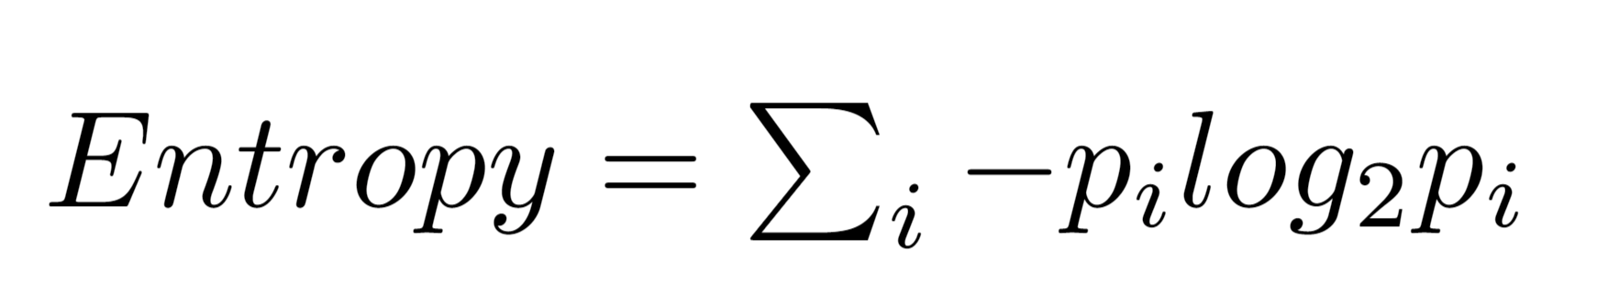
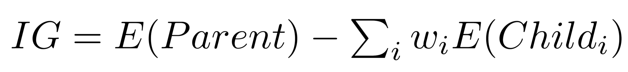
Algorithm Basics
Calculate
Calculate entropy of current node
Begin with entire dataset
Scan
Scan all possible divisions of dataset
Scan each feature
Scan possible threshold of each feature
Choose
Choose division with max information gain
Separate
Separate data accordingly
Repeat
Repeat steps 1-4 until only pure nodes achieved or max tree size reached

Slide 6
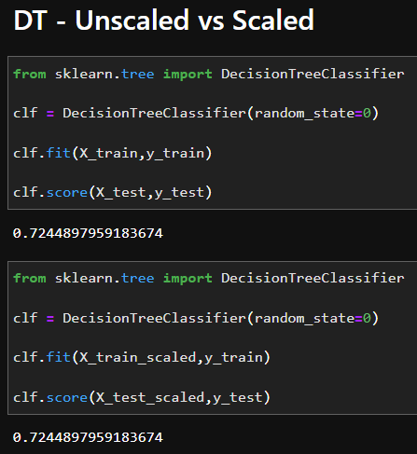
Required Data Processing Steps
Feature selection and splitting needed
Typically deals with missing values automatically
Can process both numerical and categorical data
Not as affected by outliers
Doesn’t require feature scaling

Slide 7
Scikit-Learn’s Implementation
“this module does not support missing values”
“does not support categorical variables for now”

Slide 8

Advantages
Requires little data preparation, no need to normalize data.
Able to handle multi-output problems.
The cost of using the tree is logarithmic in the number of data points used to train the tree.
Able to handle both numerical and categorical data.

Slide 9
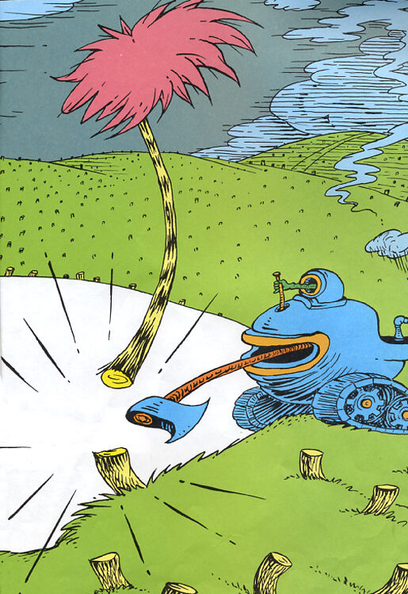
Disadvantages
Overfitting is a major concern. Tuning maximum depth of the tree is recommended as a solution.
Can be unstable because small variations in data might result in an entirely different tree being generated
Predictions are neither smooth or continuous but rather piecewise
Possible to create biased decision trees if some classes dominate

Slide 10
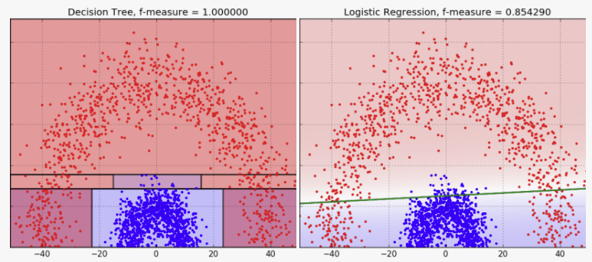
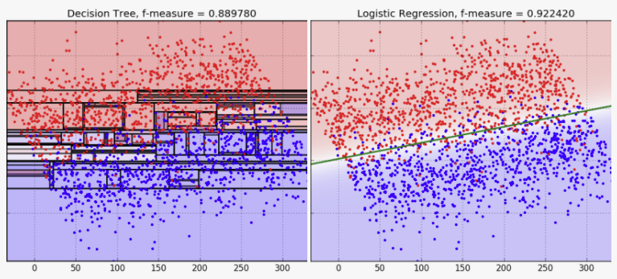
Comparison to Logistic Regression
Both are used for classification purposes
When classes are well separated the Decision Tree method classifies more accurately
However, when classes are not well separated the logistic regression more accurately classifies
Interpretability is also a difference between these two methods
Decision Tree takes more mental effort to see what decisions were made to arrive at a classification.
Logistic regression is just coefficients (probability)
https://blog.bigml.com/2016/09/28/logistic-regression-versus-decision-trees/

Slide 11
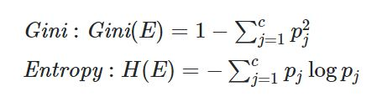
Hyperparameter
Criterion: {“gini”, “entropy”}, default=”gini”
Entropy : splits node such that it gives the most amount of information.
Gini : splits node such that it gives the least amount of impurity.
Splitter: {“best”, “random”}, default=”best”
Best: evaluates all splits using the criterion before splitting.
Random: uses a random uniform function with min_feature_value, max_feature_value and random_state as inputs.
max_depth: int, default=None
The maximum depth of the tree. If None, then nodes are expanded until all leaves are pure or until all leaves contain less than min_samples_split samples.
min_samples_split: int or float, default=2
The minimum number of samples required to split an internal node:
min_samples_leaf: int or float, default=1
The minimum number of samples required to be at a leaf node.
If float, then min_samples_split is a fraction and ceil(min_samples_split * n_samples) are the minimum number of samples for each split.
If float, then min_samples_leaf is a fraction and ceil(min_samples_leaf * n_samples) are the minimum number of samples for each node.

Slide 12
More Hyperparameter
min_weight_fraction_leaf: float, default=0.0
The minimum weighted fraction of the sum total of weights (of all the input samples) required to be at a leaf node. Samples have equal weight when sample_weight is not provided.
max_features: int, float or {“auto”, “sqrt”, “log2”}, default=None
The number of features to consider when looking for the best split.
max_leaf_nodes: int, default=None
min_impurity_decrease: float, default=0.0
A node will be split if this split induces a decrease of the impurity greater than or equal to this value.
min_impurity_decrease helps us control how deep our tree grows based on the impurity.
ccp_alpha: non-negative float, default=0.0
Complexity parameter used for Minimal Cost-Complexity Pruning. The subtree with the largest cost complexity that is smaller than ccp_alpha will be chosen. By default, no pruning is performed.
class_weight: dict, list of dict or “balanced”, default=None
Weights associated with classes in the form {class_label: weight}. If not given, all classes are supposed to have weight one. For multi-output problems, a list of dicts can be provided in the same order as the columns of y.

Slide 13
Any Questions?

Slide 14
Appendix
Simple Introductions to Decision Trees:
Helpful video on decision tree classification
Link to simple Decision Tree Algorithm Explanation
25 Questions about Decision Trees
The Complete Guide to Decision Trees
Coding Examples (farther down on page):
Decision Tree Algorithm Explained
Decision Tree Classification in Python
Specific Concepts:
Information Gain and Entropy Tutorial Slides
How to Tune Decision Tree Hyperparameters
Decision Tree VS Logistic Regression
Scikit-Learn Documentation:
1.10. Decision Trees
sklearn.tree.DecisionTreeClassifier

